Slide 1

Take Home Challenge
Role: Software Engineer
Level: Junior

Slide 2


Welcome
Foreword
Before we begin, we would like to thank you. We know that these challenges take time and we thank you for your time. We take care to read all the technical responses sent to us and we make sure to give you feedback, regardless of the outcome of your recruitment process.
Purpose
The goal of this challenge is to help us understand your software engineering abilities. Challenges, like this take home project, are intended to demonstrate the extent of a candidate's skills on their potential future role. Through this exercise, we want to get an overview of your technological knowledge, your ability to propose solutions or approaches based on the constraints inherent in the business context and the approach you will adopt when faced with a problem.
We do not expect you to spend more than a 4 hours completing the exercise. There's no hard time limit so work on it at your convenience. Take your time and submit a solution you feel proud of and ready to discuss with us.
Also, questions are definitely welcome, so ask away!

Slide 3

Description
You are part of a team responsible for the development of new services for your customers. For the next sprints, you and your team will be in charge of the UI and the API. The first features are related to the user management
1
Write a REST API using Spring and the reactive paradigm. The REST API must be connected to a SQL or NoSQL database and have to expose 2 routes: list all the users in the database or get a user by its unique identifier. The user model is expected to contain at least a unique identifier, a name and creation datetime of the user in the database.
2
Create a Docker image to package the API
3
Develop a simple UI using Angular or React to interact with the API. The home page have to list all the users in a list or a table. On a click on of the user, the details of the user is displayed
4
Create a Docker image to package the UI
5
Create a Docker compose to deploy the whole project
6
In these slides, explain:
what are the limitation of your actual solution
how you can improve it, using an other technology or an other pattern
how you can setup this kind of solution at scale in production with a detailed architecture

Slide 4

How?
Rules
you can add the dependencies of your choice but you must use Spring for the API, and React or Angular for the UI
you can use all the technological solutions/frameworks that seem useful to you
feel free to use this presentation if you want to add schemas, drawing…
you will be challenged on the quality of your code and the organization of your solution, but also on the documentation, the architecture and overall solution design, the relevance of the technical choices, the appropriate use of source control...
you are expected to be able to explain your solution in a face-to-face interview. During the interview, you’ll have also to be able to justify the technical choices, your implementation and the advantages and limitations of your solution.
Deliverables
your application should be able to be run “as-is”
all source code should be able to be built in a Linux environment.
include database scripts with DDL you deem necessary and any other prequisites
include any deployment instructions in a readme.md file. These can include manual steps that need to be run first.
also in a readme.md file, explain:
how you can deploy this kind of application in production
what are the limitation of this solution
how you can improve it, using an other technology or an other pattern
what are the advantages and disadvantages of using the reactive programming paradigm

Slide 5



Your solution
Feel free to use this slide or create new slides to explain your solution
Add architecture schemas or database DDL…
Add code portions if you want to focus on a specific item…
Or anything else!

Slide 6

What next?
invite our github user "littlebigcode-codereview" to be a collaborator on the repository
let us (your interview coordinator) know when you are ready to review
one of our coaches will contact you to discuss with you about your solution, your choice of solutions, the overall architecture... stay tuned!

Slide 7
Proposed Solution
Role: Software Engineer
Level: Junior

Slide 8
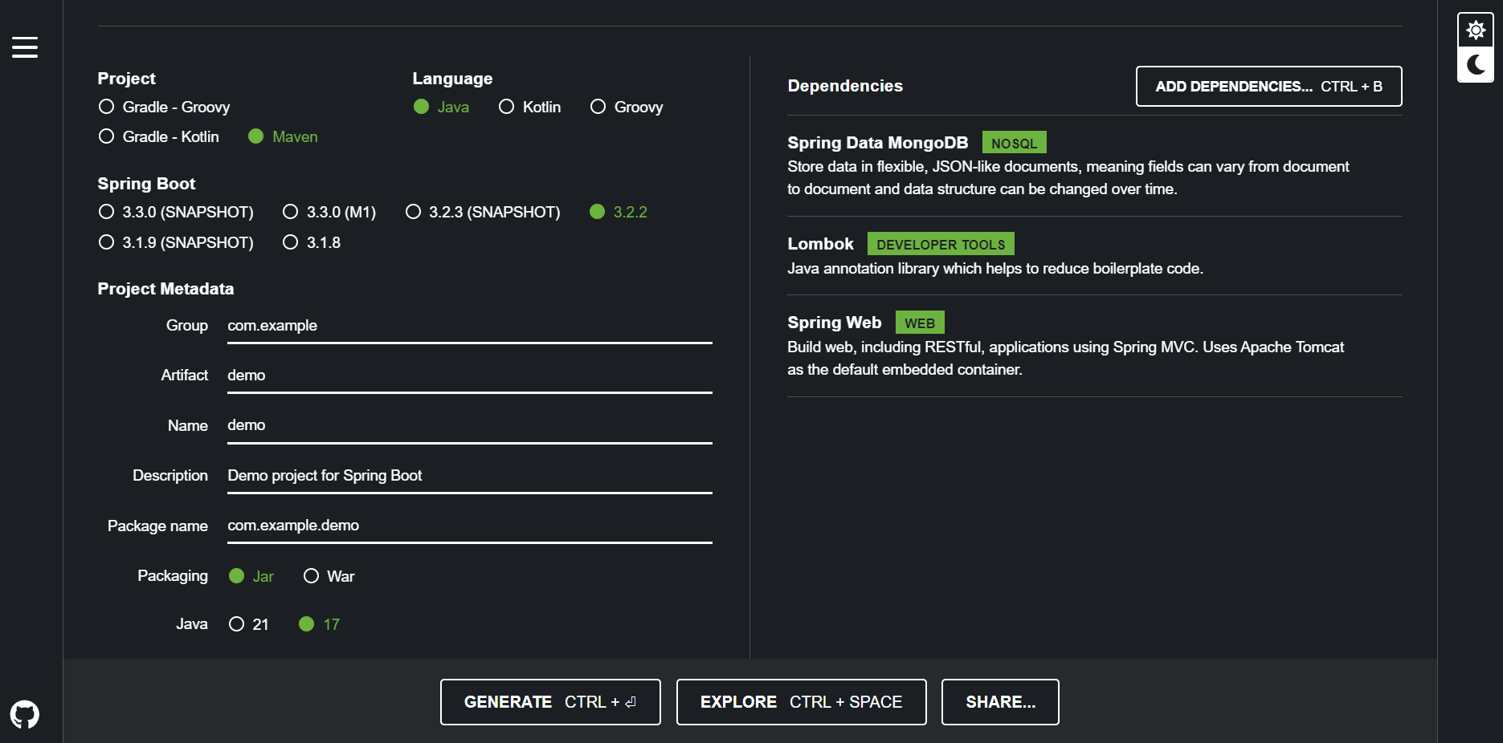
Backend
Figure 1. Spring initalizr tool to init the project

Slide 9
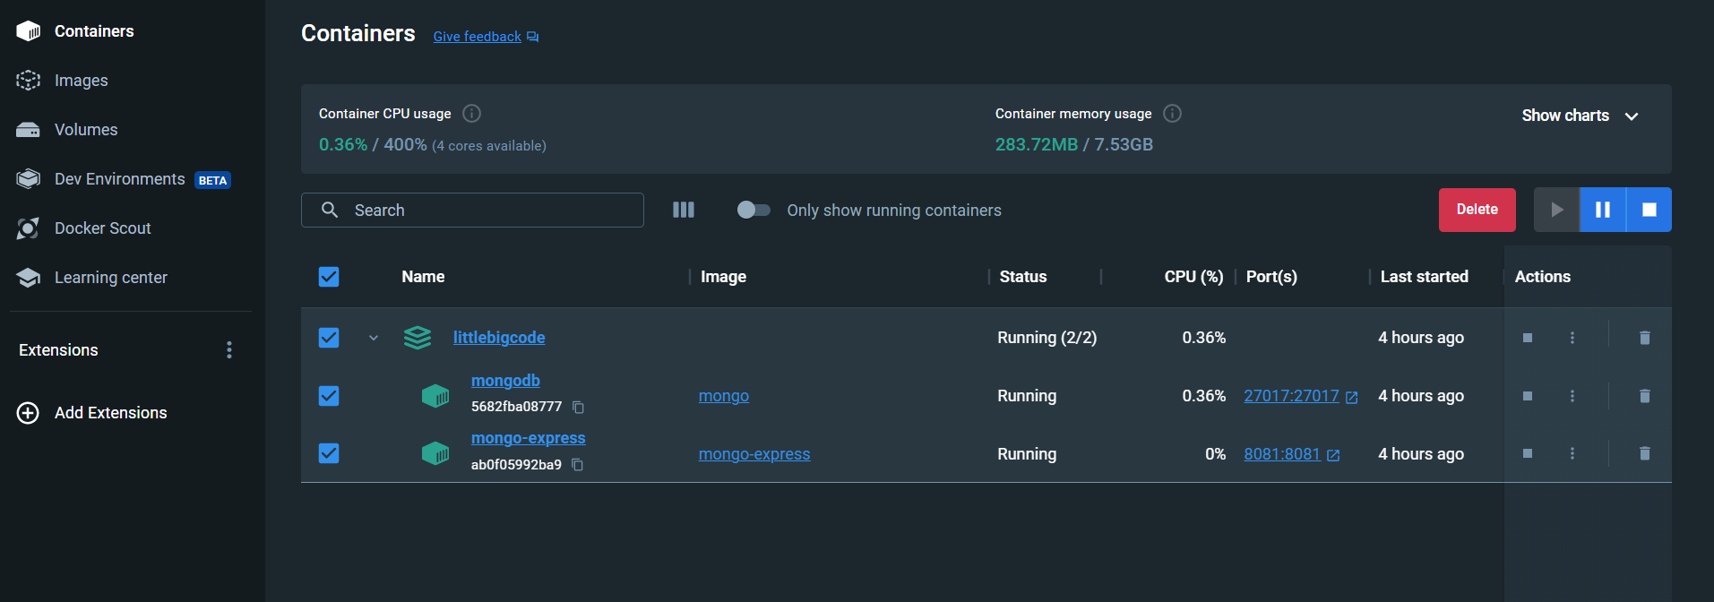
Backend
Figure 2. Database Containers on Docker

Slide 10
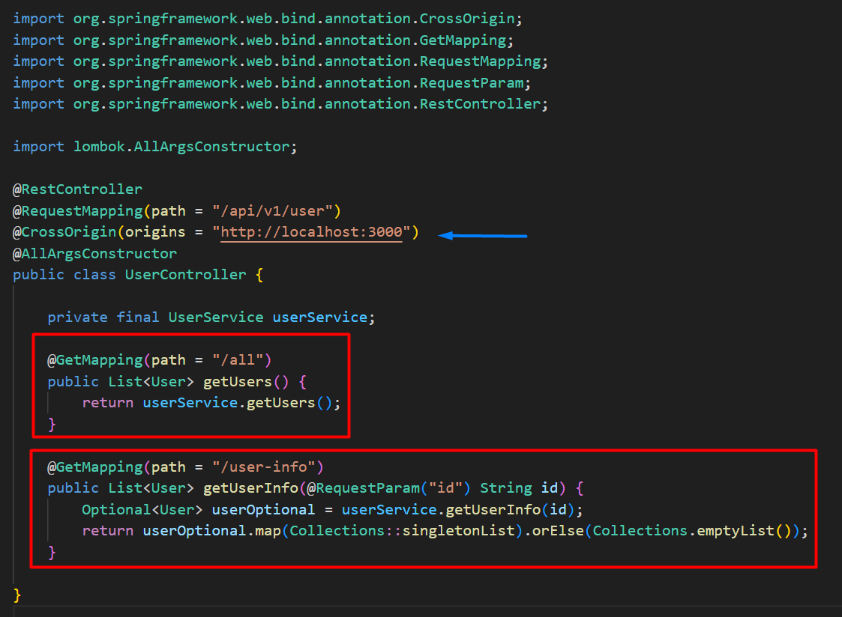
Backend
Figure 3. API Endpoints
Notice we are using the
CrossOrigin decorator to avoid the Cross origin issue from the front app

Slide 11
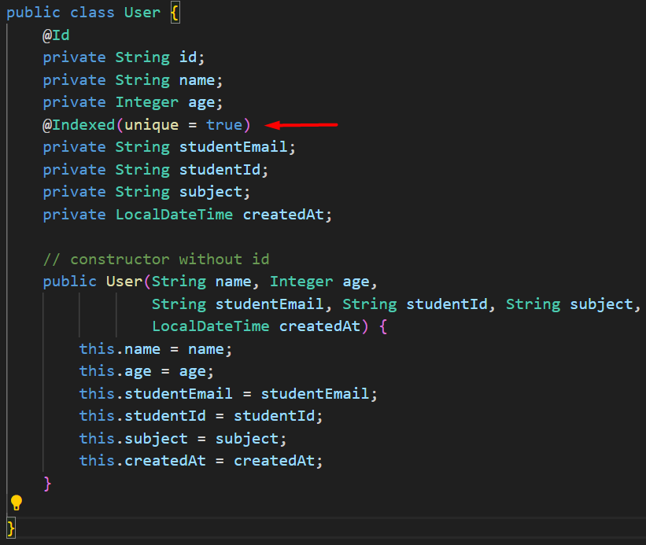
Backend
Figure 4. User Class Schema
Notice we are using the
Indexed decorator to verify the uniqueness of the studentEmail property

Slide 12
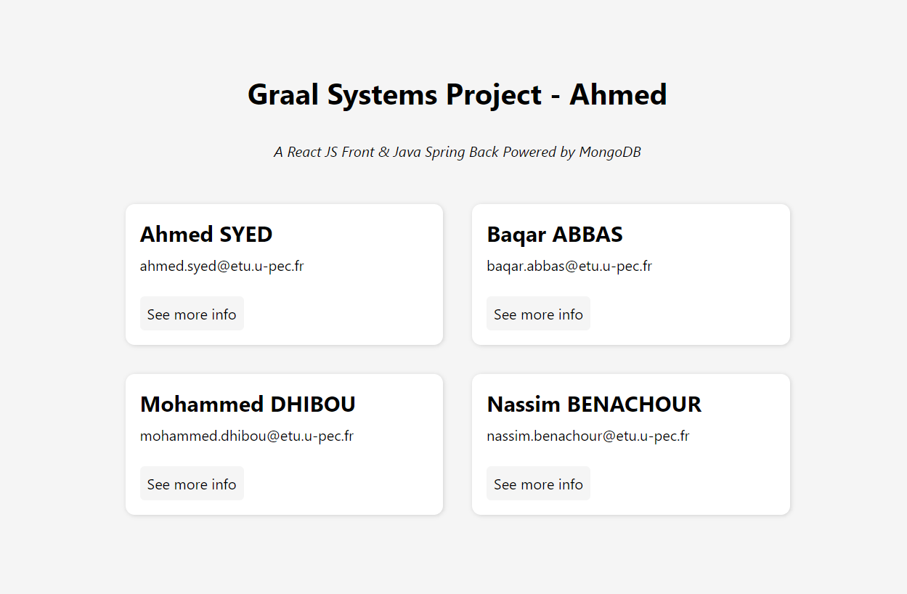
Frontend
Figure 5. Minimalist looking landing page with all the users
Note that these users are being fetched from the DB inside a useEffect block (see Fig 7b.).

Slide 13
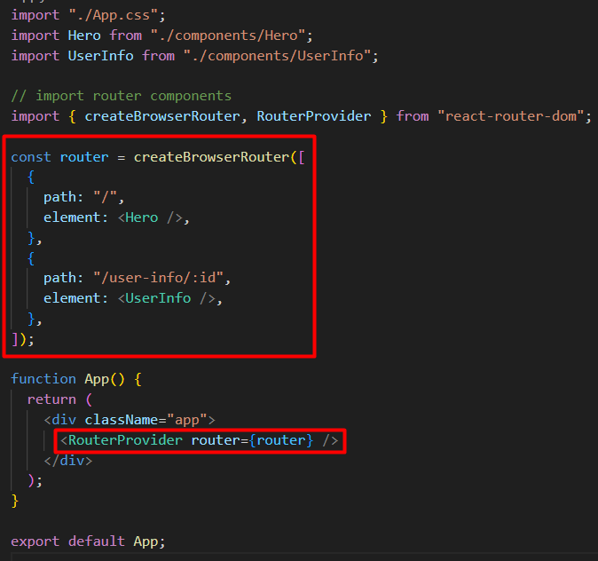
Frontend
Figure 6. Setup routes in the front end application

Slide 14
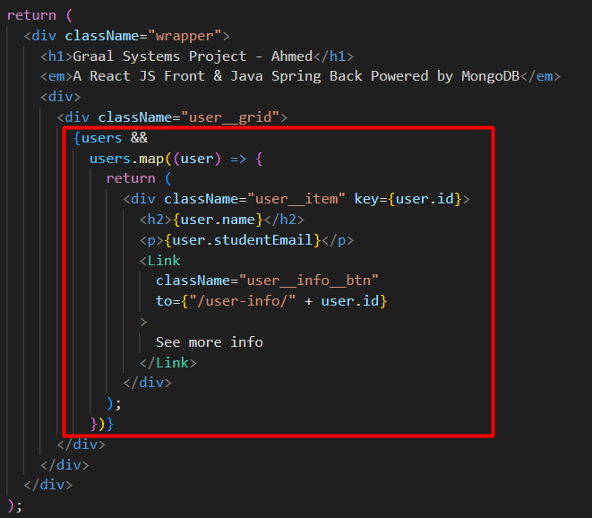
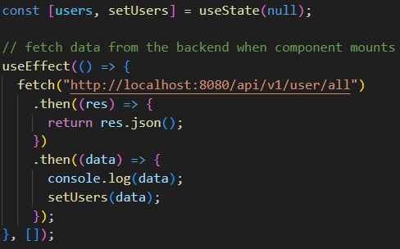
Frontend
Figure 7a. Example of api call from the useEffect block
Figure 7b. Consuming the data by mapping through it

Slide 15

Thanks
This document includes icons by Flaticon and infographics & images by Freepik

